Slide 1
Knowledge Representation

Slide 2
Knowledge representation and knowledge engineering are central to AI research.
Many of the problems machines are expected to solve will require extensive knowledge about the world. Among the things that AI needs to represent are: objects, properties, categories and relations between objects; situations, events, states and time; causes and effects knowledge about knowledge (what we know about what other people know); and many other, less well researched domains. A representation of "what exists" is an ontology (borrowing a word from traditional philosophy), of which the most general are called upper ontologies.

Slide 3
Knowledge representation (KR) is an area of artificial intelligence research aimed at representing knowledge in symbols to facilitate inferencing from those knowledge elements, creating new elements of knowledge.

Slide 4
A good knowledge representation covers six basic characteristics:
Coverage, which means the KR covers a breadth and depth of information. Without a wide coverage, the KR cannot determine anything or resolve ambiguities.
Understandable by humans. KR is viewed as a natural language, so the logic should flow freely. It should support modularity and hierarchies of classes (Polar bears are bears, which are animals). It should also have simple primitives that combine in complex forms.
Consistency. If John closed the door, it can also be interpreted as the door was closed by John. By being consistent, the KR can eliminate redundant or conflicting knowledge.
Efficient
Easiness for modifying and updating.
Supports the intelligent activity which uses the knowledge base

Slide 5
Knowledge-based Systems
Knowledge-based Systems: A definition
A system that draws upon the knowledge of human experts captured in a knowledge-base to solve
problems that normally require human expertise.
Heuristic rather than algorithmic
Heuristics in search vs. in KBS
general vs. domain-specific
Highly specific domain knowledge
Knowledge is separated from how it is used
KBS = knowledge-base + inference engine

Slide 6
KBS Architecture

Slide 7
KBS Architecture

Slide 8
KBS tools
KBS tools – Shells
Consist of KA Tool, Database & Development Interface
- Inductive Shells
- simplest
- example cases represented as matrix of known data
(premises) and resulting effects (conclusions)
- matrix converted into decision tree or IF-THEN statements
- examples selected for the tool
Rule-based shells
- simple to complex
- IF-THEN rules

Slide 9
KBS tools
Hybrid shells
- sophisticate & powerful
- support multiple KR paradigms & reasoning schemes
- generic tool applicable to a wide range
Special purpose shells
- specifically designed for particular types of problems
- restricted to specialized problems
Scratch
- require more time and effort
- no constraints like shells
- shells should be investigated first

Slide 10
Typical tasks of KBS
(1) Diagnosis - To identify a problem given a set of symptoms or malfunctions.
e.g. diagnose reasons for engine failure
(2) Interpretation - To provide an understanding of a situation from available information. e.g. DENDRAL
(3) Prediction - To predict a future state from a set of data or observations. e.g. Drilling Advisor, PLANT
(4) Design - To develop configurations that satisfy constraints of a design problem. e.g. XCON
(5) Planning - Both short term & long term in areas like project management, product development or financial planning.
e.g. HRM
(6) Monitoring - To check performance & flag exceptions.
e.g., KBS monitors radar data and estimates the position of
the space shuttle
(7) Control - To collect and evaluate evidence and form opinions on that evidence.
e.g. control patient’s treatment
(8) Instruction - To train students and correct their performance. e.g. give medical students experience diagnosing illness
(9) Debugging - To identify and prescribe remedies for malfunctions.
e.g. identify errors in an automated teller machine network and ways to correct the errors

Slide 11
Advantages & Limitations
Advantages
Increase availability of expert knowledge
expertise not accessible
training future experts
Efficient and cost effective
Consistency of answers
Explanation of solution
Deal with uncertainty

Slide 12
Limitations
Lack of common sense
Inflexible, Difficult to modify
Restricted domain of expertise
Lack of learning ability
Not always reliable

Slide 13
Knowledge Representation:
What to Represent?
Using Knowledge
Properties for Knowledge Representation Systems
Approaches to Knowledge Representation
Simple relational knowledge
Inheritable knowledge
Inferential Knowledge
Procedural Knowledge
Issue in Knowledge Representation

Slide 14
What to Represent?
Let us first consider what kinds of knowledge might need to be represented in AI systems:
Objects
-- Facts about objects in our world domain. e.g. Guitars have strings, trumpets are brass instruments.
Events
-- Actions that occur in our world. e.g. Steve Vai played the guitar in Frank Zappa's Band.
Performance
-- A behavior like playing the guitar involves knowledge about how to do things.
Meta-knowledge
-- knowledge about what we know. e.g. Bobrow's Robot who plan's a trip. It knows that it can read street signs along the way to find out where it is.
Thus in solving problems in AI we must represent knowledge and there are two entities to deal with:
Facts
-- truths about the real world and what we represent. This can be regarded as the knowledge level
Representation of the facts
which we manipulate. This can be regarded as the symbol level since we usually define the representation in terms of symbols that can be manipulated by programs.
We can structure these entities at two levels
the knowledge level
-- at which facts are described
the symbol level
-- at which representations of objects are defined in terms of symbols that can be manipulated in programs

Slide 15
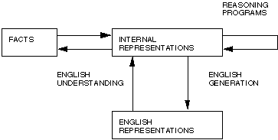
Two Entities in Knowledge Representation

Slide 16
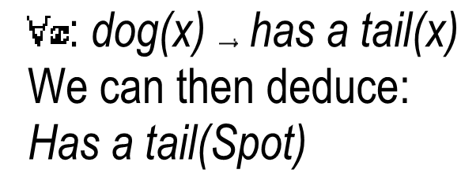
What to Represent?
English or natural language is an obvious way of representing and handling facts. Logic enables us to consider the following fact: spot is a dog as dog(spot) We could then infer that all dogs have tails with:

Slide 17
Using Knowledge
We have briefly mentioned where knowledge is used in AI systems. Let us consider a little further to what applications and how knowledge may be used.
Learning
-- acquiring knowledge. This is more than simply adding new facts to a knowledge base. New data may have to be classified prior to storage for easy retrieval, etc.. Interaction and inference with existing facts to avoid redundancy and replication in the knowledge and and also so that facts can be updated.
Retrieval
-- The representation scheme used can have a critical effect on the efficiency of the method. Humans are very good at it.
Many AI methods have tried to model human (see lecture on distributed reasoning)
Reasoning
Infer facts from existing data.
If a system on only knows:
Miles Davis is a Jazz Musician.
All Jazz Musicians can play their instruments well.
If things like Is Miles Davis a Jazz Musician? or Can Jazz Musicians play their instruments well? are asked then the answer is readily obtained from the data structures and procedures.
However a question like Can Miles Davis play his instrument well? requires reasoning.
The above are all related. For example, it is fairly obvious that learning and reasoning involve retrieval etc.

Slide 18
Properties for Knowledge Representation Systems
The following properties should be possessed by a knowledge representation system.
Representational Adequacy
-- the ability to represent the required knowledge;
Inferential Adequacy
- the ability to manipulate the knowledge represented to produce new knowledge corresponding to that inferred from the original;
Inferential Efficiency
- the ability to direct the inferential mechanisms into the most productive directions by storing appropriate guides;
Acquisitional Efficiency
- the ability to acquire new knowledge using automatic methods wherever possible rather than reliance on human intervention.

Slide 19
Types of Knowledge
Simple relational knowledge
The simplest way of storing facts is to use a relational method where each fact about a set of objects is set out systematically in columns. This representation gives little opportunity for inference, but it can be used as the knowledge basis for inference engines.
Simple way to store facts.
Each fact about a set of objects is set out systematically in column.
Little opportunity for inference.
Knowledge basis for inference engines.

Slide 20
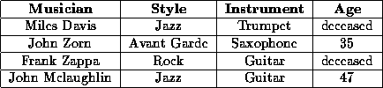
Simple relational knowledge
Figure: Simple Relational Knowledge
We can ask things like:
Who is dead?
Who plays Jazz/Trumpet etc.?
This sort of representation is popular in database systems.

Slide 21
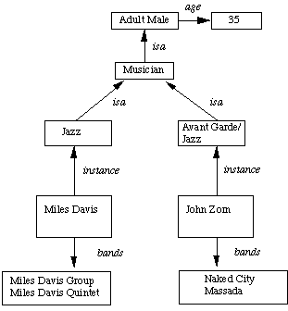
Relational knowledge is made up of objects consisting of attributes corresponding associated values. We extend the base more by allowing inference mechanisms: Property inheritance elements inherit values from being members of a class. data must be organised into a hierarchy of classes .
The algorithm to retrieve a value for an attribute of an instance object:
Find the object in the knowledge base
If there is a value for the attribute report it
Otherwise look for a value of instance if none fail
Otherwise go to that node and find a value for the attribute and then report it
Otherwise search through using isa until a value is found for the attribute.
Property Inheritance Hierarchy
Boxed nodes -- objects and values of attributes of objects.
Values can be objects with attributes and so on.
Arrows -- point from object to its value.
This structure is known as a slot and filler structure, semantic network or a collection of frames.

Slide 22
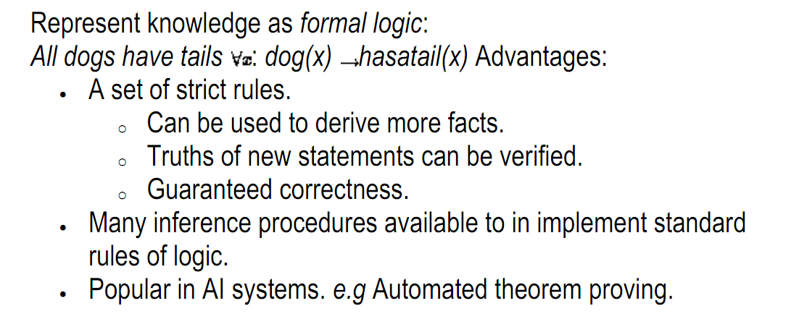
Inferential Knowledge

Slide 23
Procedural Knowledge
Basic idea:
Knowledge encoded in some procedures
small programs that know how to do specific things, how to proceed.
e.g a parser in a natural language understander has the knowledge that a noun phrase may contain articles, adjectives and nouns. It is represented by calls to routines that know how to process articles, adjectives and nouns.
Advantages:
Heuristic or domain specific knowledge can be represented.
Extended logical inferences, such as default reasoning facilitated.
Side effects of actions may be modelled. Some rules may become false in time. Keeping track of this in large systems may be tricky.
Disadvantages:
Completeness -- not all cases may be represented.
Consistency -- not all deductions may be correct.
e.g If we know that Fred is a bird we might deduce that Fred can fly. Later we might discover that Fred is an emu.
Modularity is sacrificed. Changes in knowledge base might have far-reaching effects.
Cumbersome control information.

Slide 24
Procedural Knowledge Representations
Declarative or Procedural?
Declarative knowledge representation:
Static representation -- knowledge about objects, events etc. and their relationships and states given.
Requires a program to know what to do with knowledge and how to do it.
Procedural representation:
control information necessary to use the knowledge is embedded in the knowledge itself. e.g. how to find relevant facts, make inferences etc.
Requires an interpreter to follow instructions specified in knowledge.

Slide 25
Weak Slot and Filler Structures
Semantic Nets
Representation in a Semantic Net
Inference in a Semantic Net
Extending Semantic Nets
Frames
Frame Knowledge Representation
Interpreting frames

Slide 26
Why use this data structure?
It enables attribute values to be retrieved quickly
assertions are indexed by the entities
binary predicates are indexed by first argument. E.g. team(Mike-Hall , Cardiff).
Properties of relations are easy to describe .
It allows ease of consideration as it embraces aspects of object oriented programming.
So called because:
A slot is an attribute value pair in its simplest form.
A filler is a value that a slot can take -- could be a numeric, string (or any data type) value or a pointer to another slot.
A weak slot and filler structure does not consider the content of the representation.

Slide 27
Semantic Nets
Semantic networks are an alternative to predicate logic as a form of knowledge representation. The idea is that we can store our knowledge in the form of a graph, with nodes representing objects in the world, and arcs representing relationships between those objects.
The major idea is that:
The meaning of a concept comes from its relationship to other concepts, and that,
The information is stored by interconnecting nodes with labelled arcs.
Representation in a Semantic Net
Inference in a Semantic Net
Extending Semantic Nets

Slide 28
Draw the semantic network to represent the following data
Tom is a cat.
Tom caught a bird.
Tom is owned by john.
Tom is brown in color.
Cats like cream.
The cat sat on the mat.
A cat is a mammal.
All mammals are animals

Slide 29
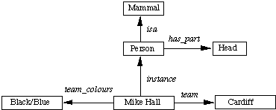
Semantic Net

Slide 30
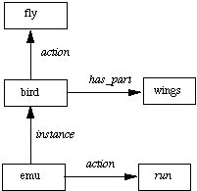
Inference in a Semantic Net
Basic inference mechanism: follow links between nodes.
Two methods to do this:
Intersection search
-- the notion that spreading activation out of two nodes and finding their intersection finds relationships among objects. This is achieved by assigning a special tag to each visited node.
Many advantages including entity-based organisation and fast parallel implementation. However very structured questions need highly structured networks.
Inheritance
-- the isa and instance representation provide a mechanism to implement this.
Inheritance also provides a means of dealing with default reasoning. E.g. we could represent:
Emus are birds.
Typically birds fly and have wings.
Emus run.
in the following Semantic net:

